Slide 1
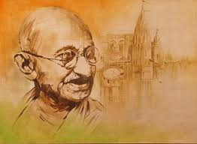
GANDHIAN PHILOSOPHY AND 21ST CENTURY EDUCATION SYSTEM
Developed by
Dr. Sanjukta Padhi
(Asst Prof., School of Psychology)
G.M.University,Sambalpur, Odisha

Slide 2
Background of Gandhi
Born on 2nd Oct. 1869 Porbander( Western Coast of India)
A great Socio-Political reformer.
Champion of Freedom fighter.
Peace and Non-violence.
Satyagraha and various other movment 1919 to 1947.
Died on 30th Jan 1948.

Slide 3
His Philosophy:
Truth, Ahimsa, Love and morality.
Brotherhood of man.
Service to Humanity.
Satyagraha.

Slide 4
Educational Philosophy:
“ Live as if you were to die tomorrow; Learn as if you were to live forever.”
Education as a potent force for social reconstruction.
An activity for social, moral, political and Economic development.

Slide 5
Meaning of Education:
“ By education, I mean an all-round drawing out of the best in the child and man, body, mind and spirit.”
“Literacy in itself in not education.”

Slide 6
Basic Education(Nai Taleem) Scheme:
Free and compulsory education for all from 7-14 year.
Craft as the centre of education.
Self- supporting education
Mother tongue as he medium.
Ideals of citizenship.
Co-operative living.
Emphasis on non-violence.
No religious education.

Slide 7
All the same....
Basic education Scheme.
Nayi Talim.
Craft-based Eduction Scheme.
Wardha Scheme.

Slide 8
ThanQ

